Slide 1
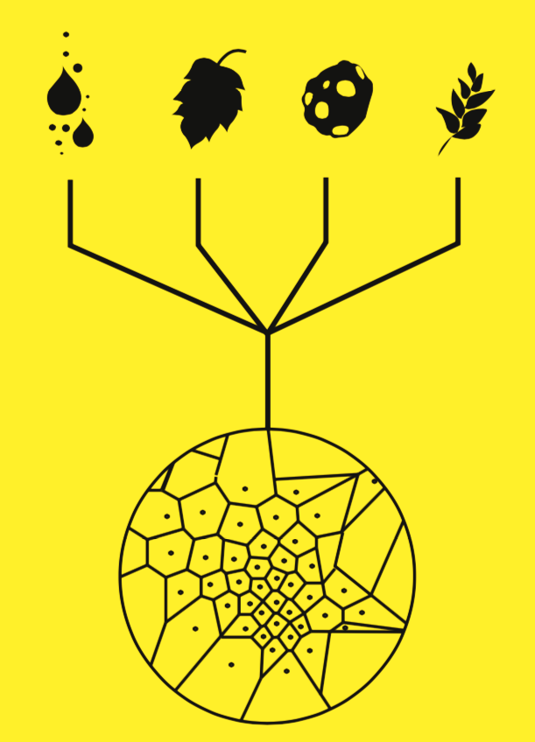
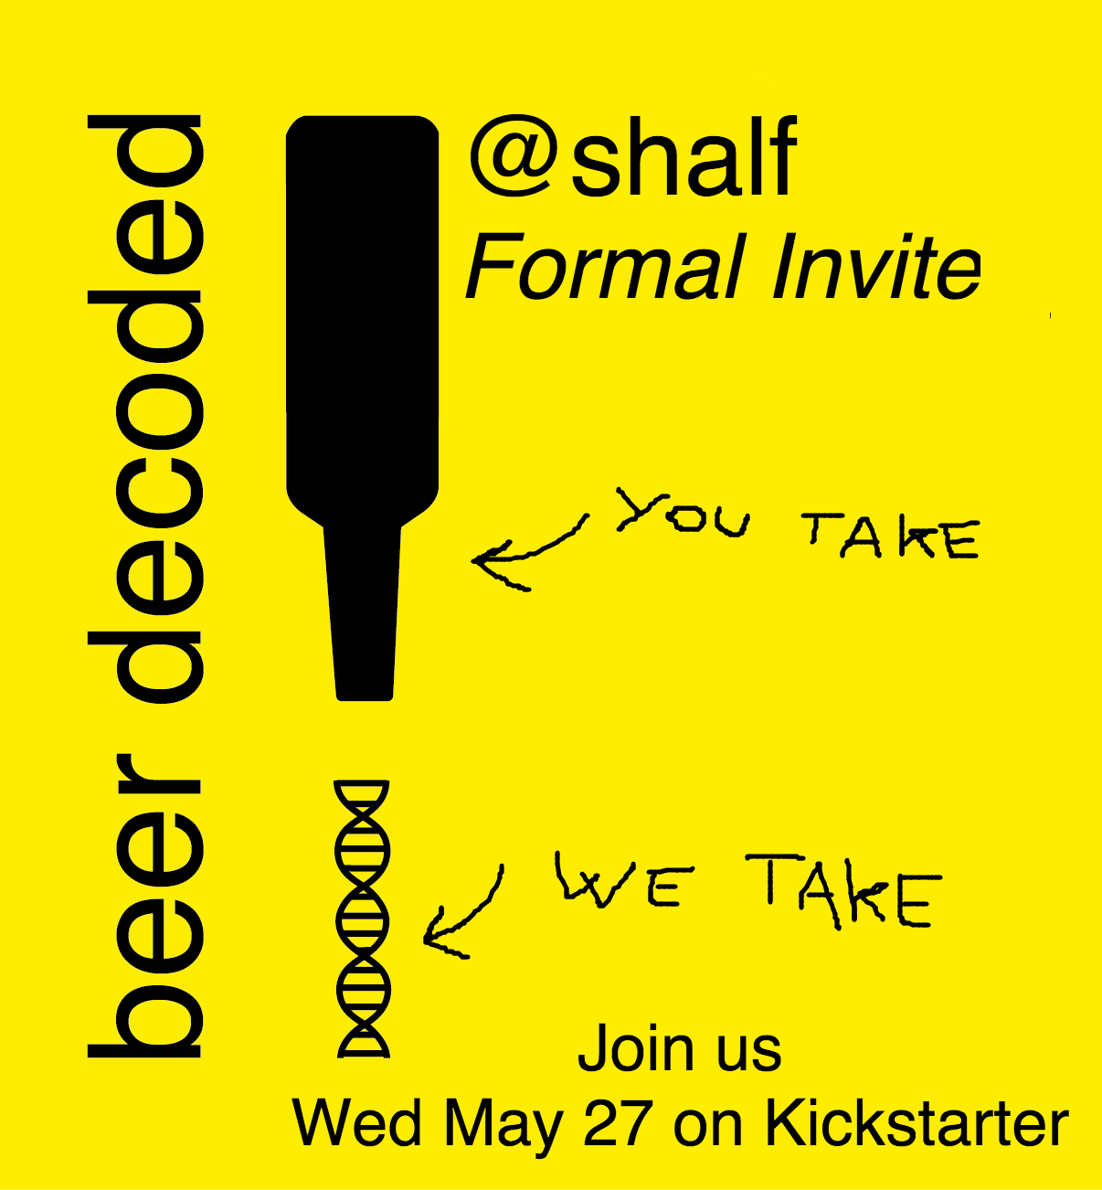
BeerDeCoded:
Exploring the beer metagenome
www.genome.beer
@beerdecoded
Jonathan Sobel
@jonathansobel1

Slide 2
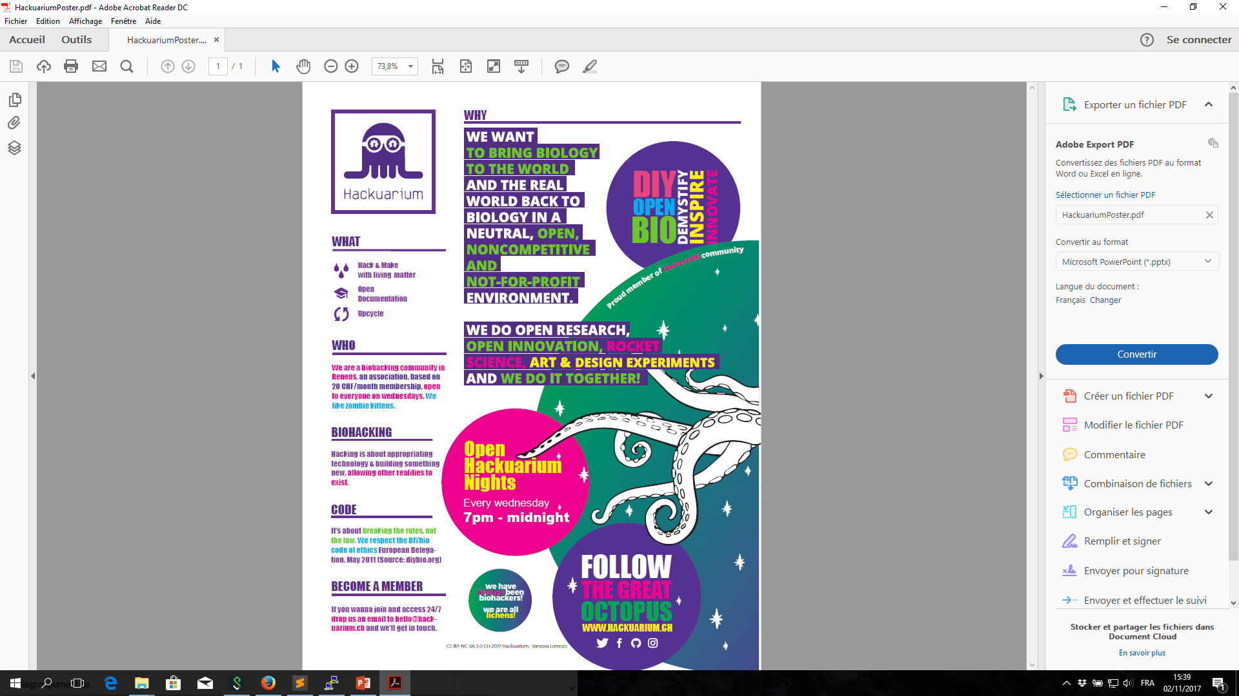

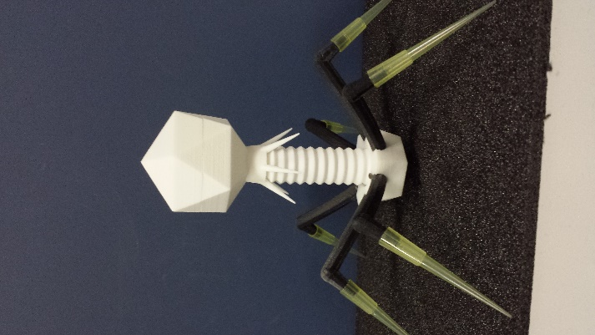
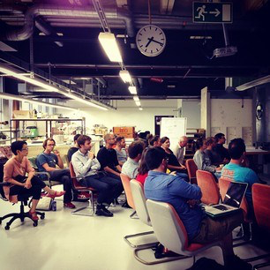
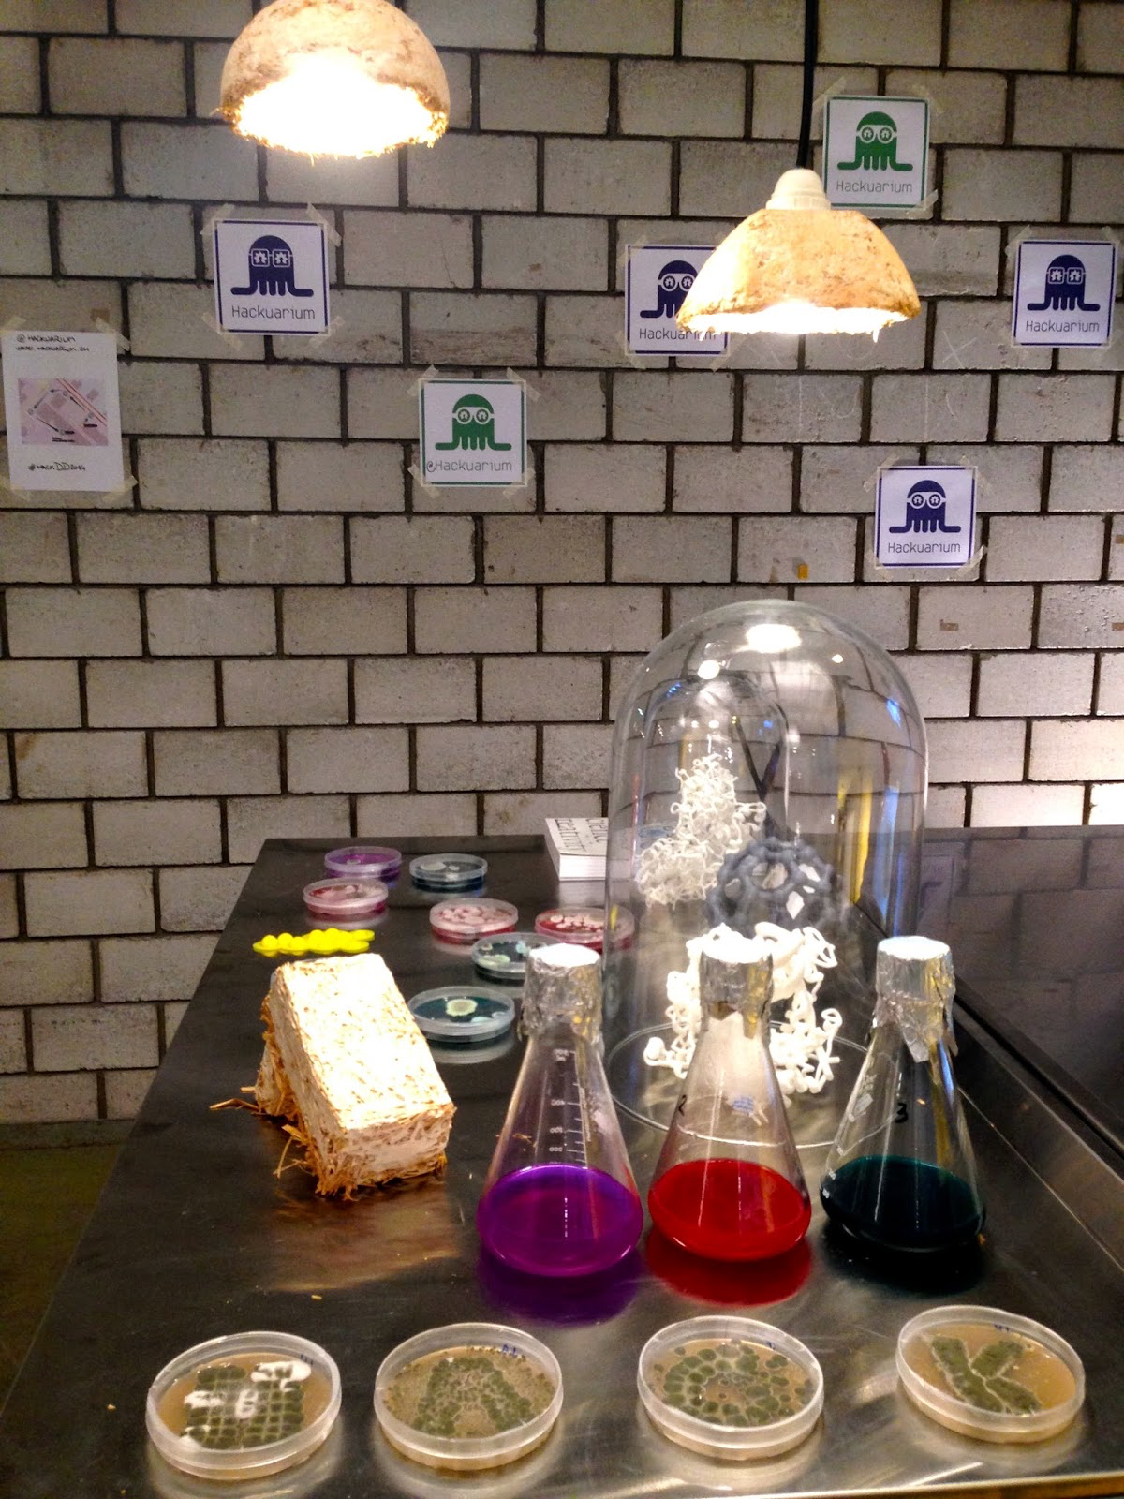
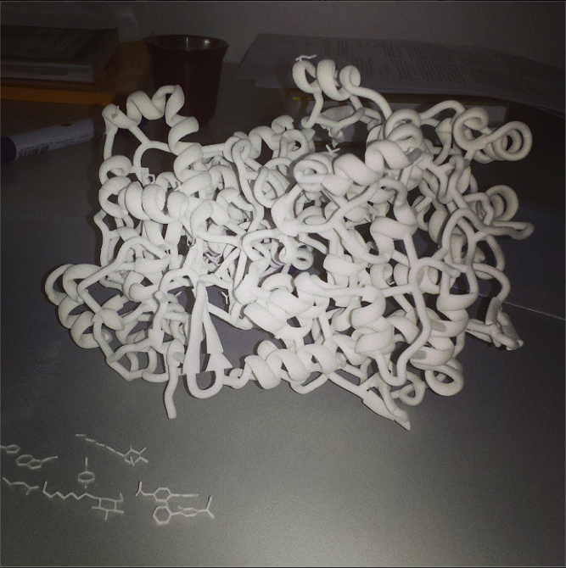
Hackuarium.ch
Projects in biology/science, bio-art and education
Workshops, Outreach
Citizen science, DIY-biology
www.hackuarium.ch

Slide 3
Science outside academia or industry

Slide 4
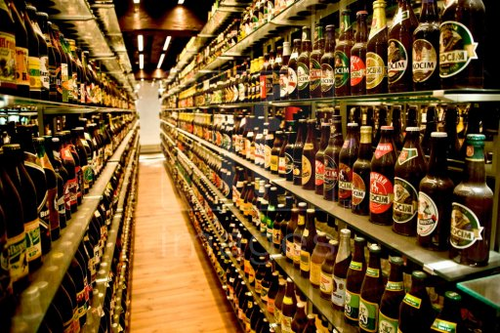
Why Beers?

Slide 5
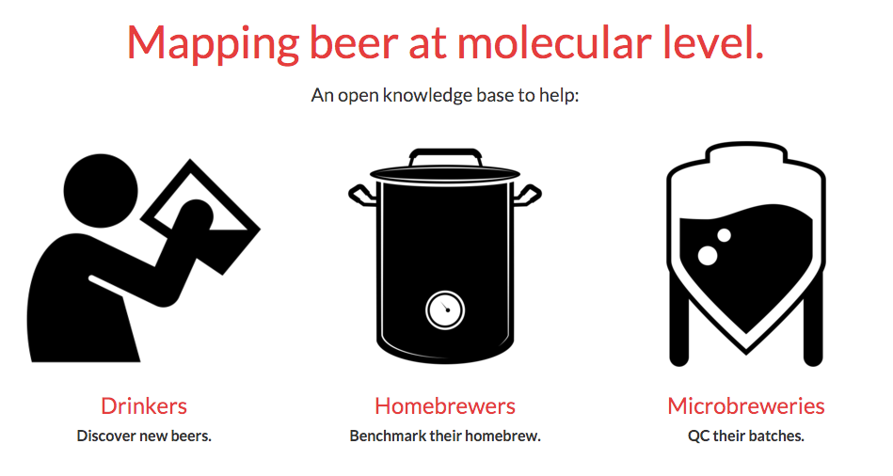
1.2M
6k
www.genome.beer

Slide 6
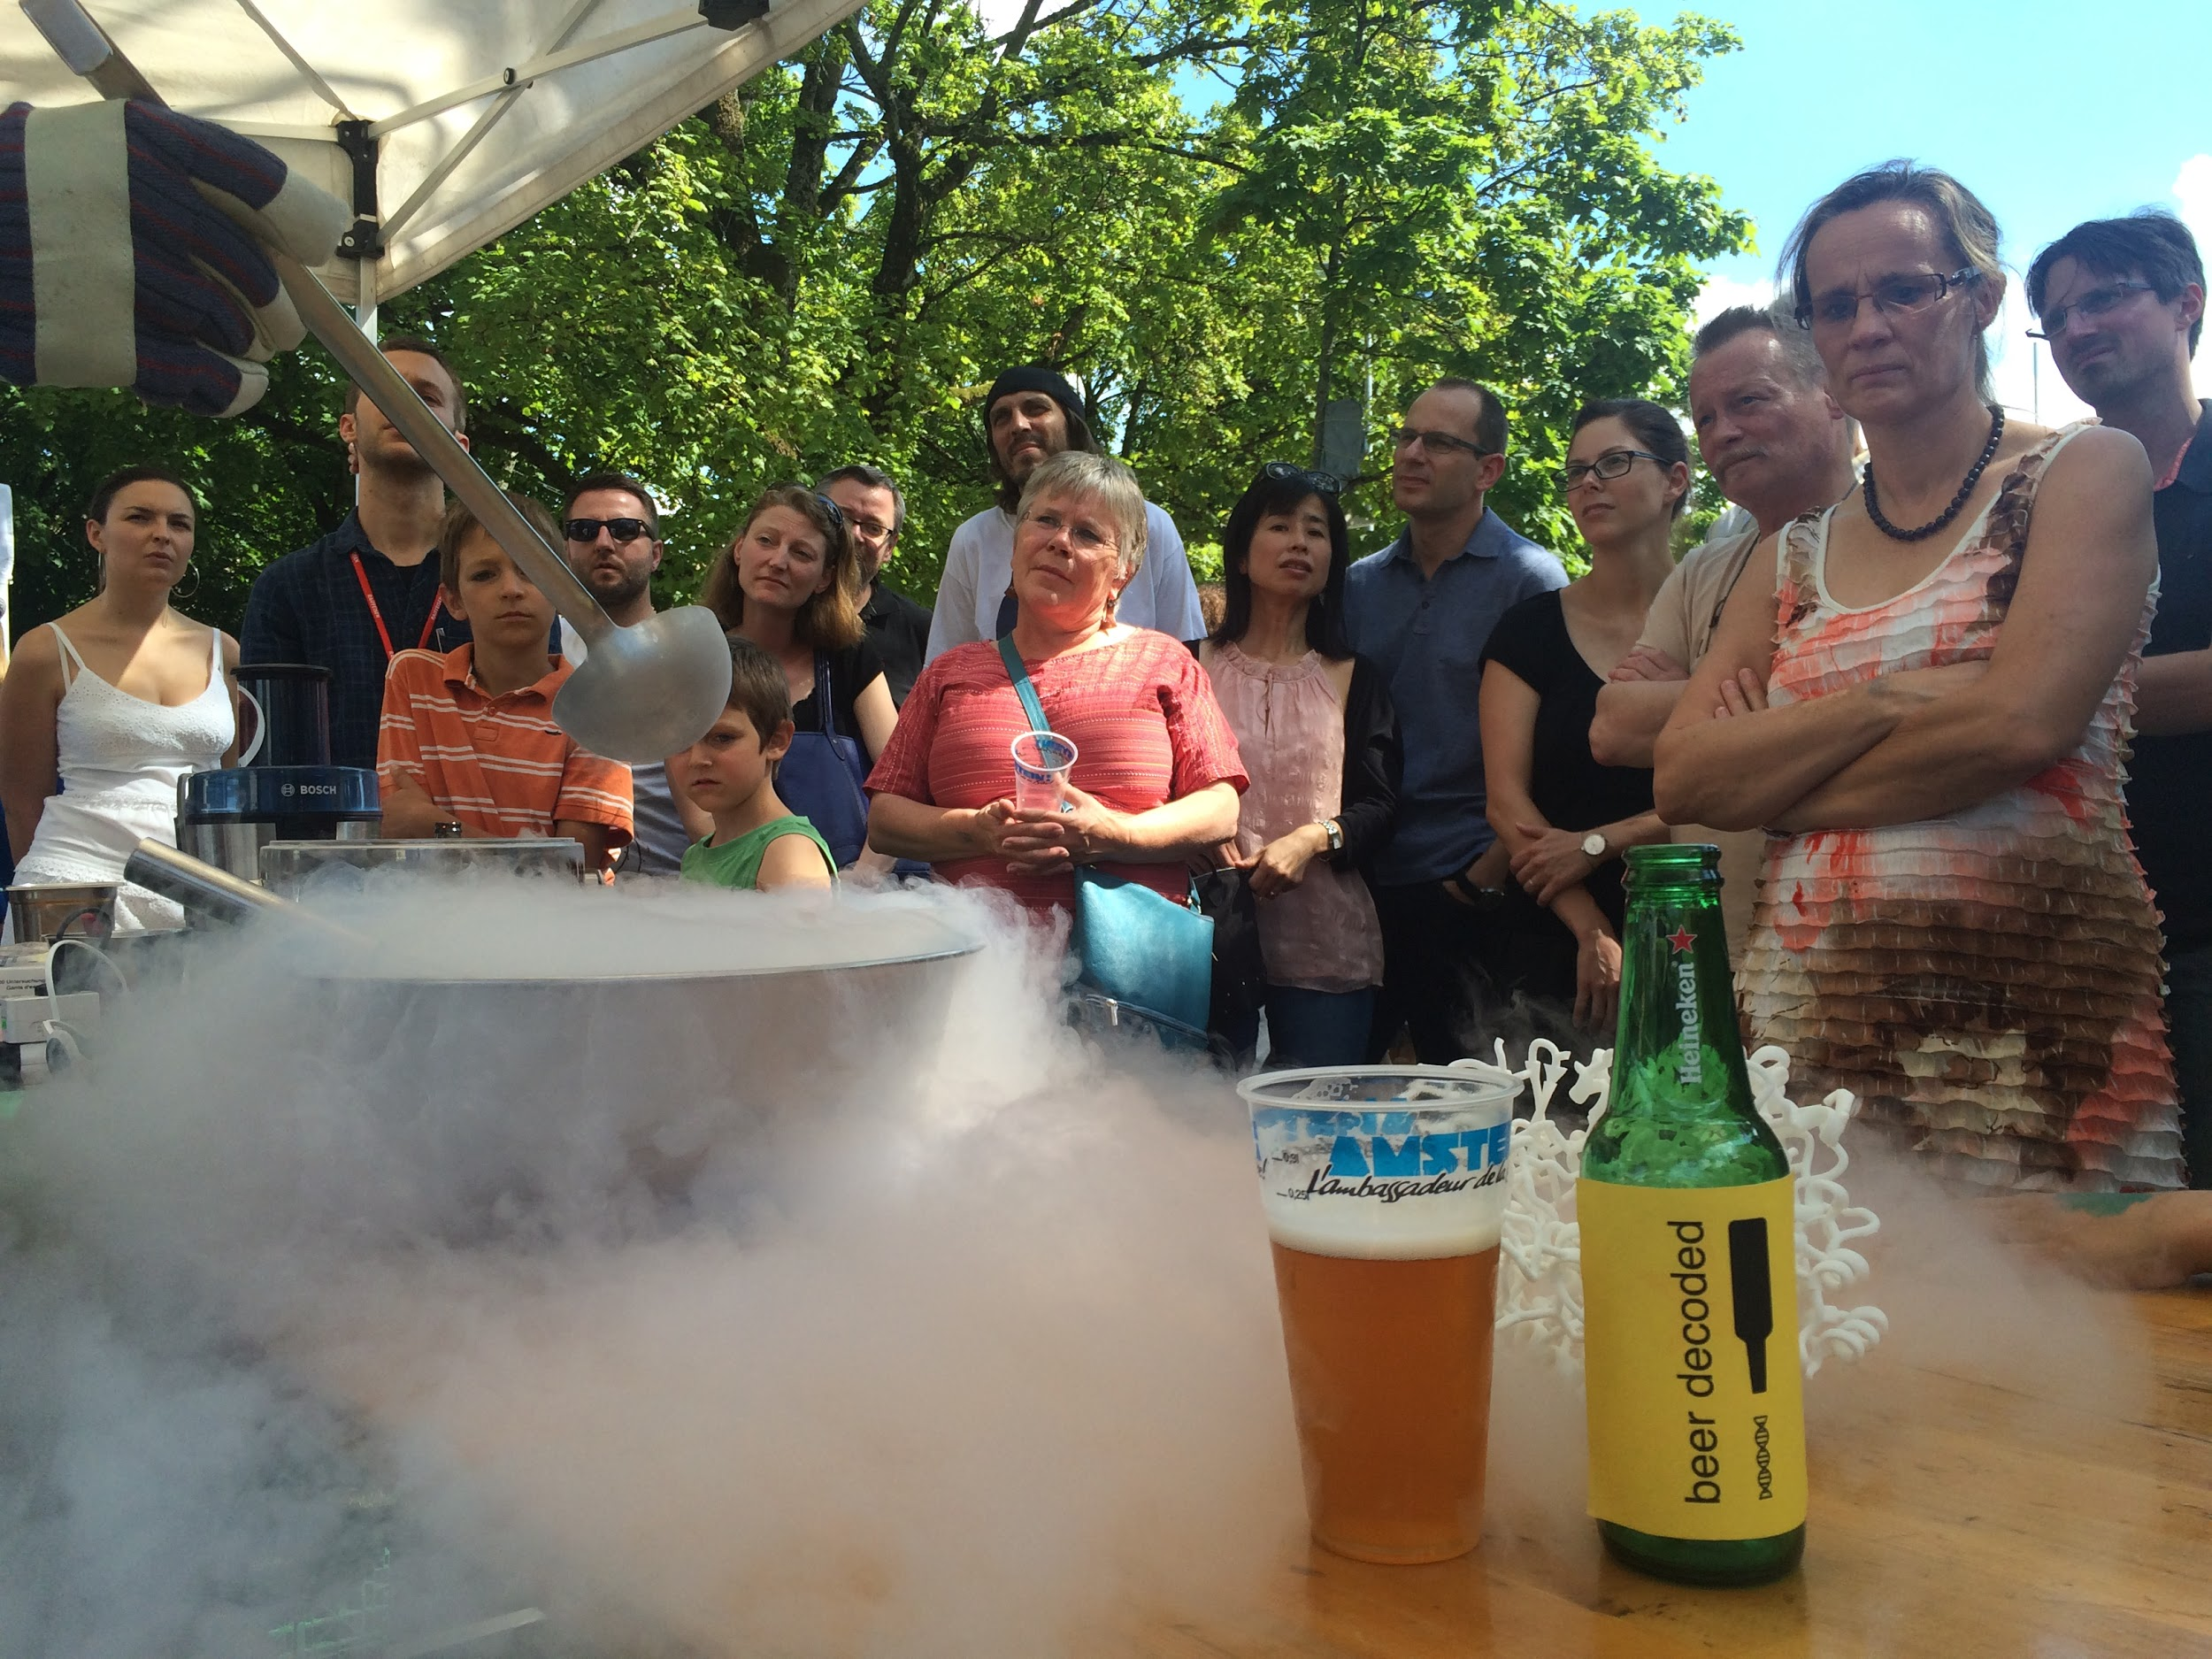
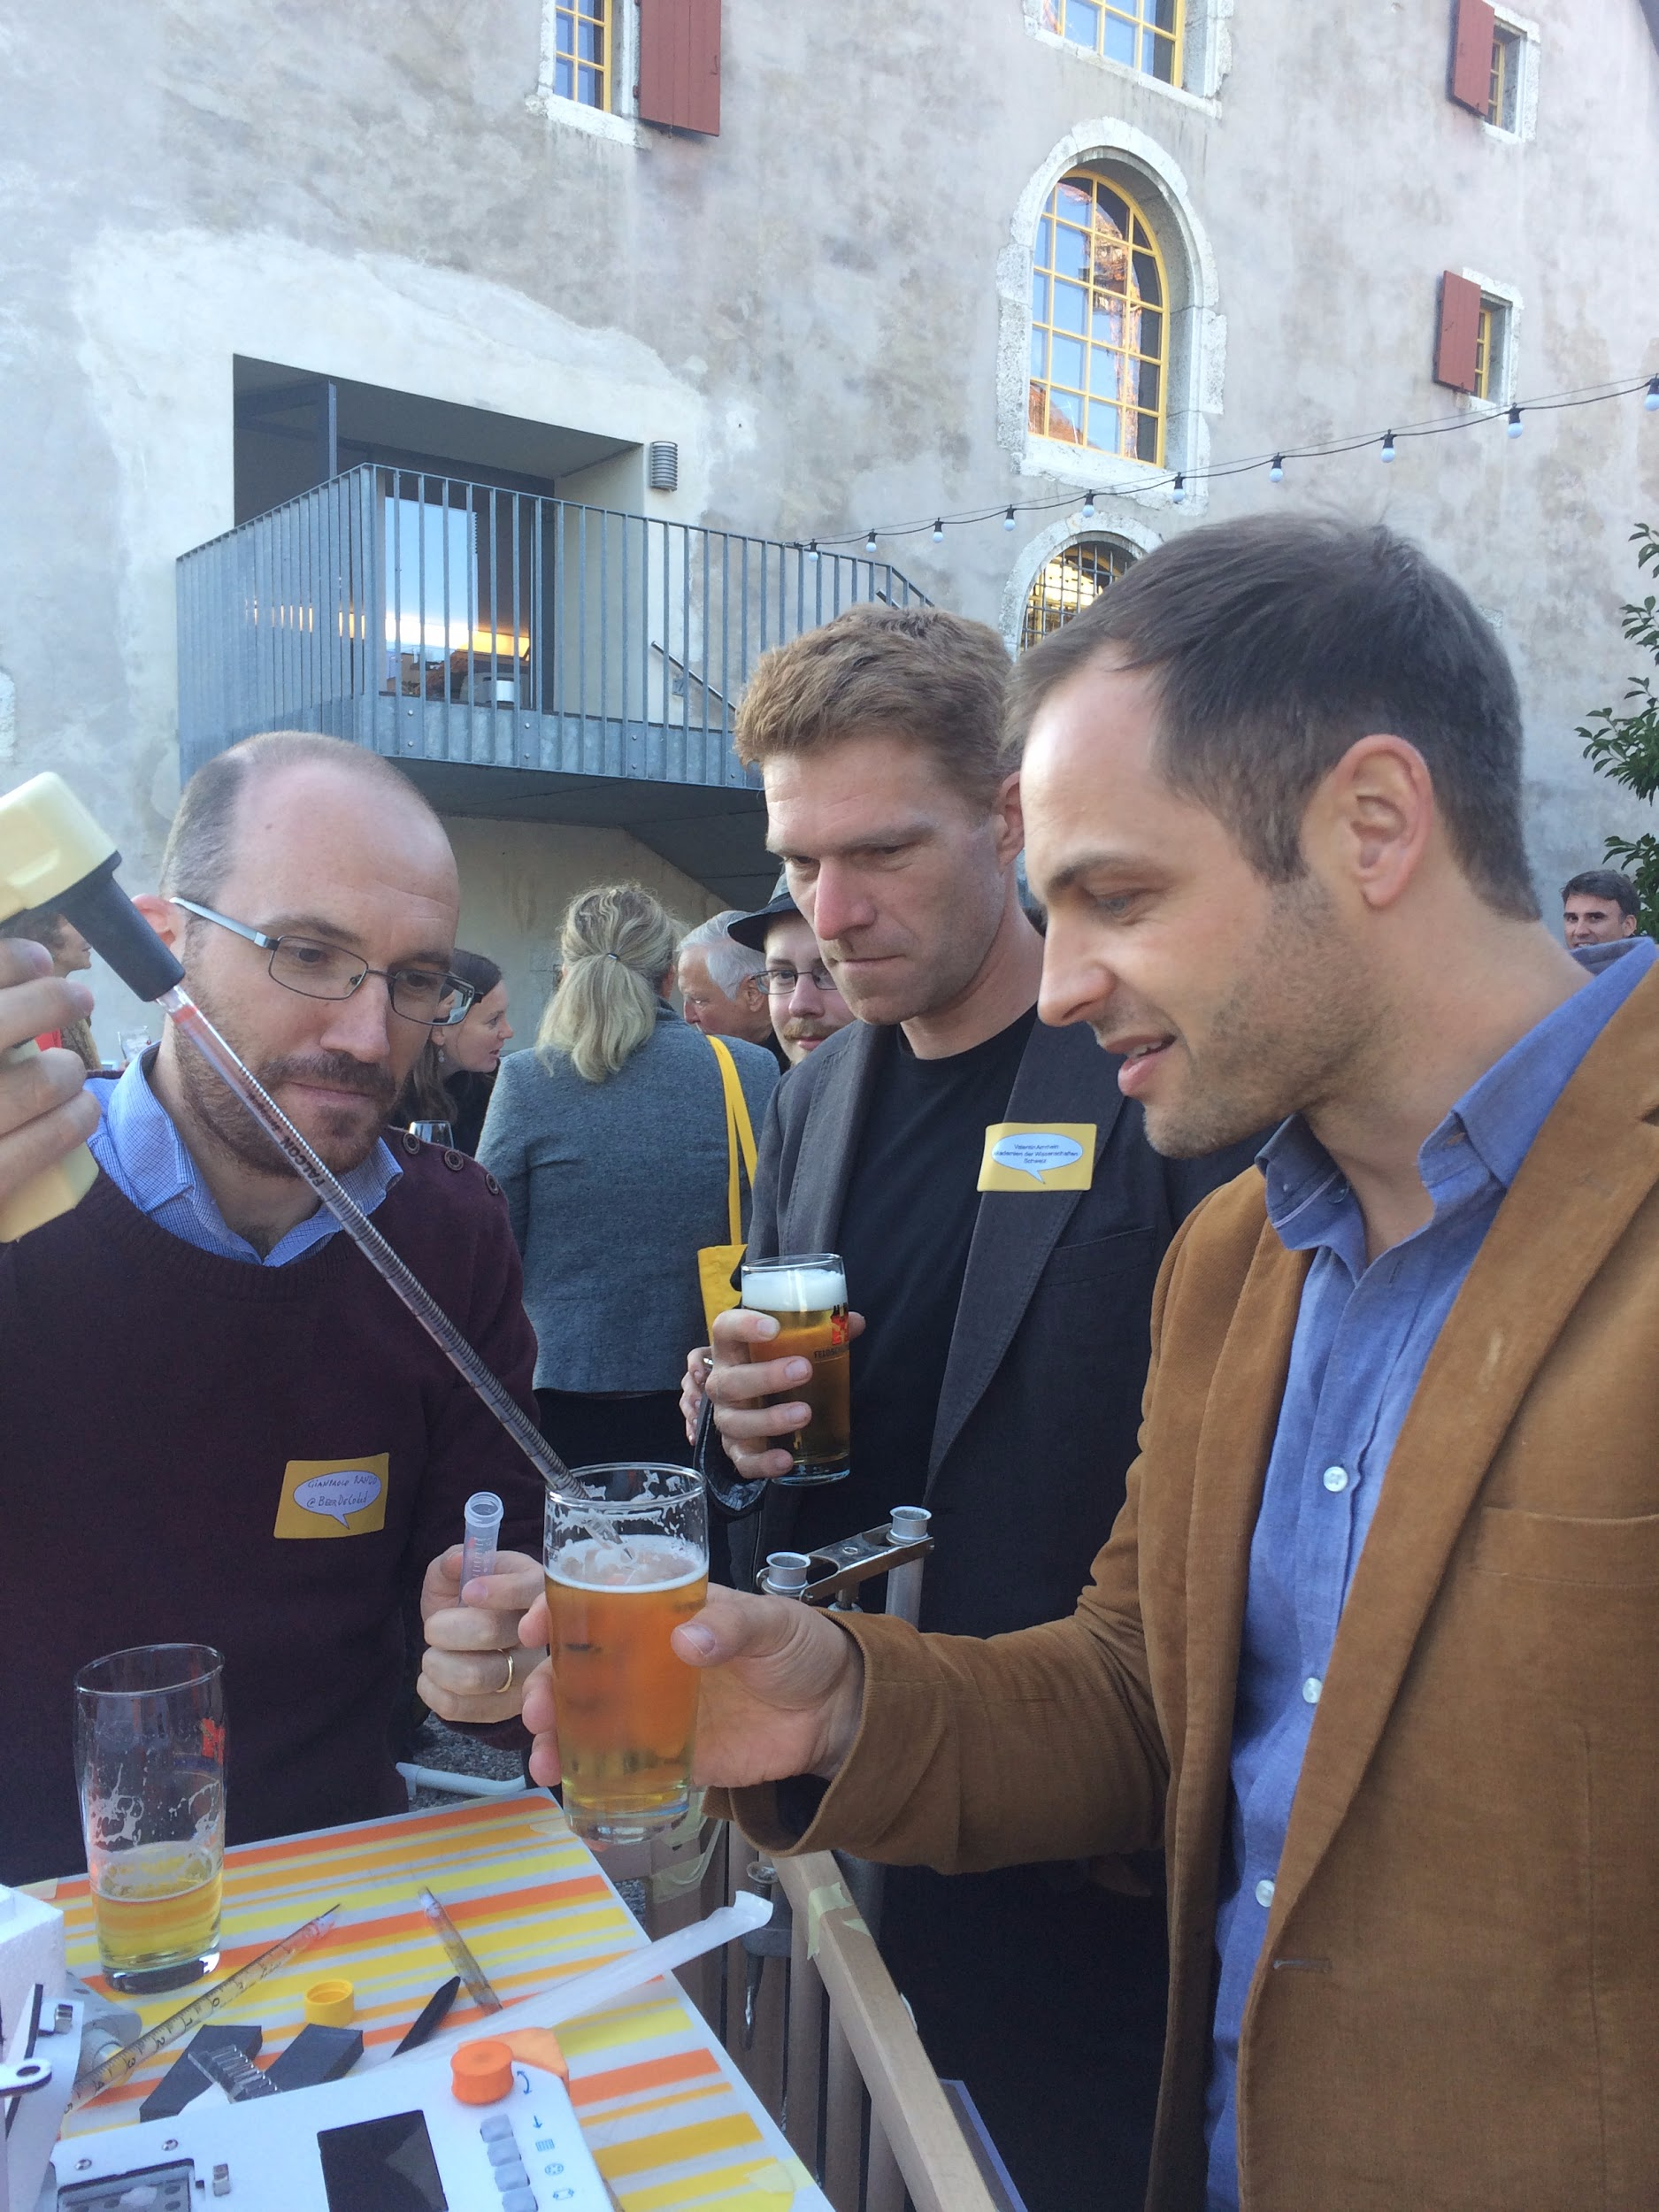
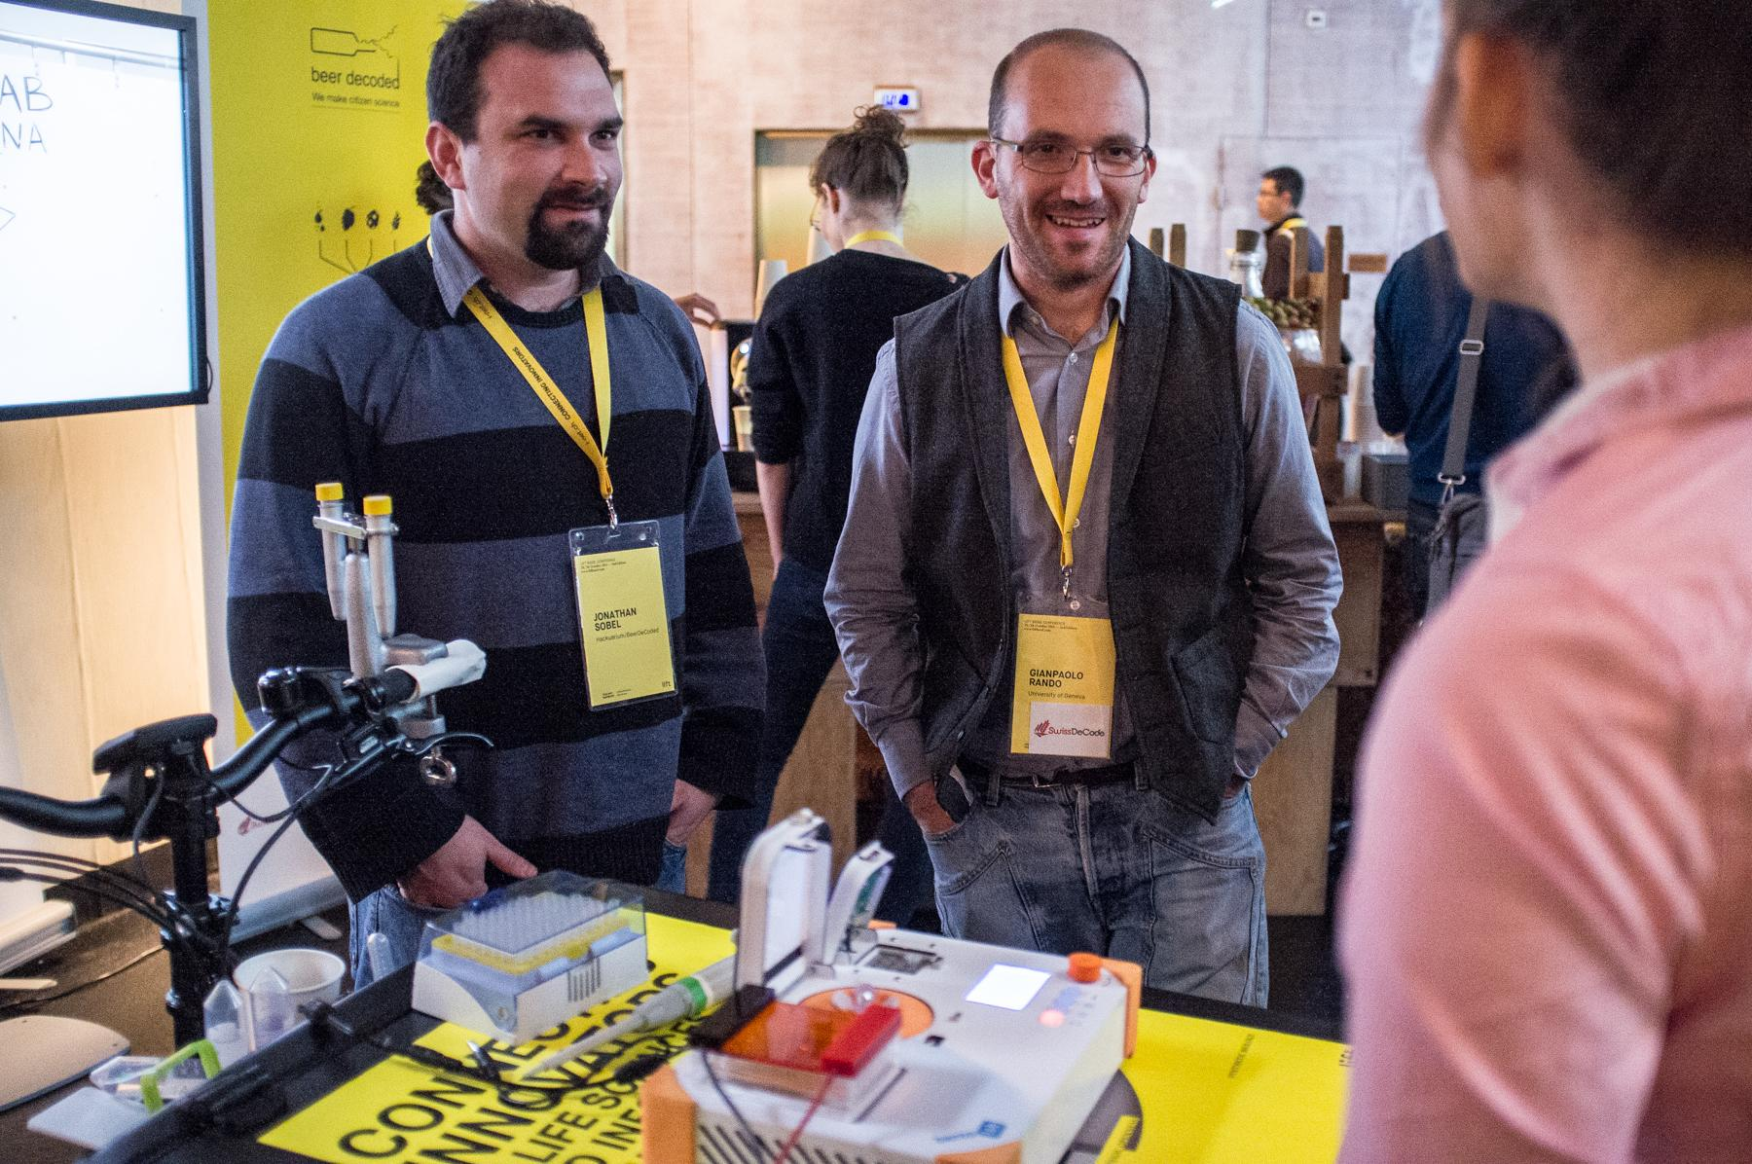
Beer testing on a cargo bike

Slide 7
Money ?

Slide 8
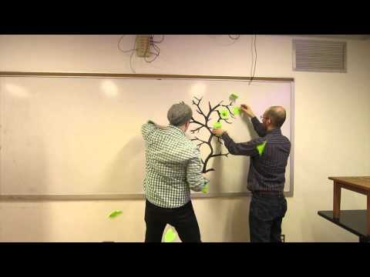

video: www.genome.beer
It’s time for beeromics!

Slide 9
Communicate

Slide 10
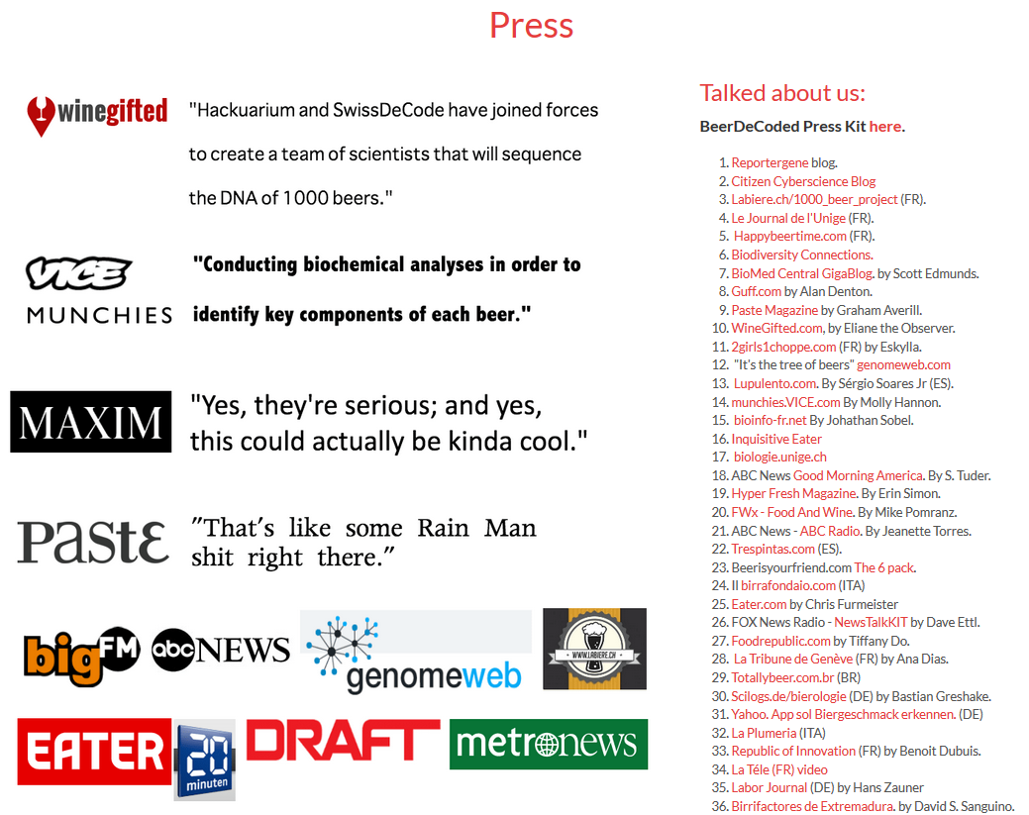
Press release
La Tele

Slide 11
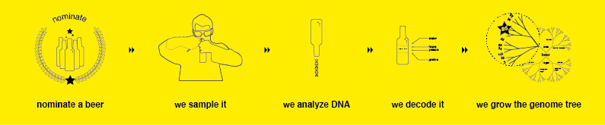
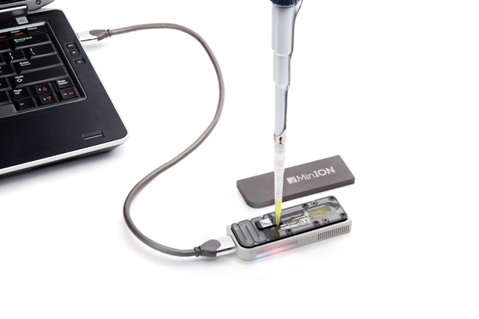
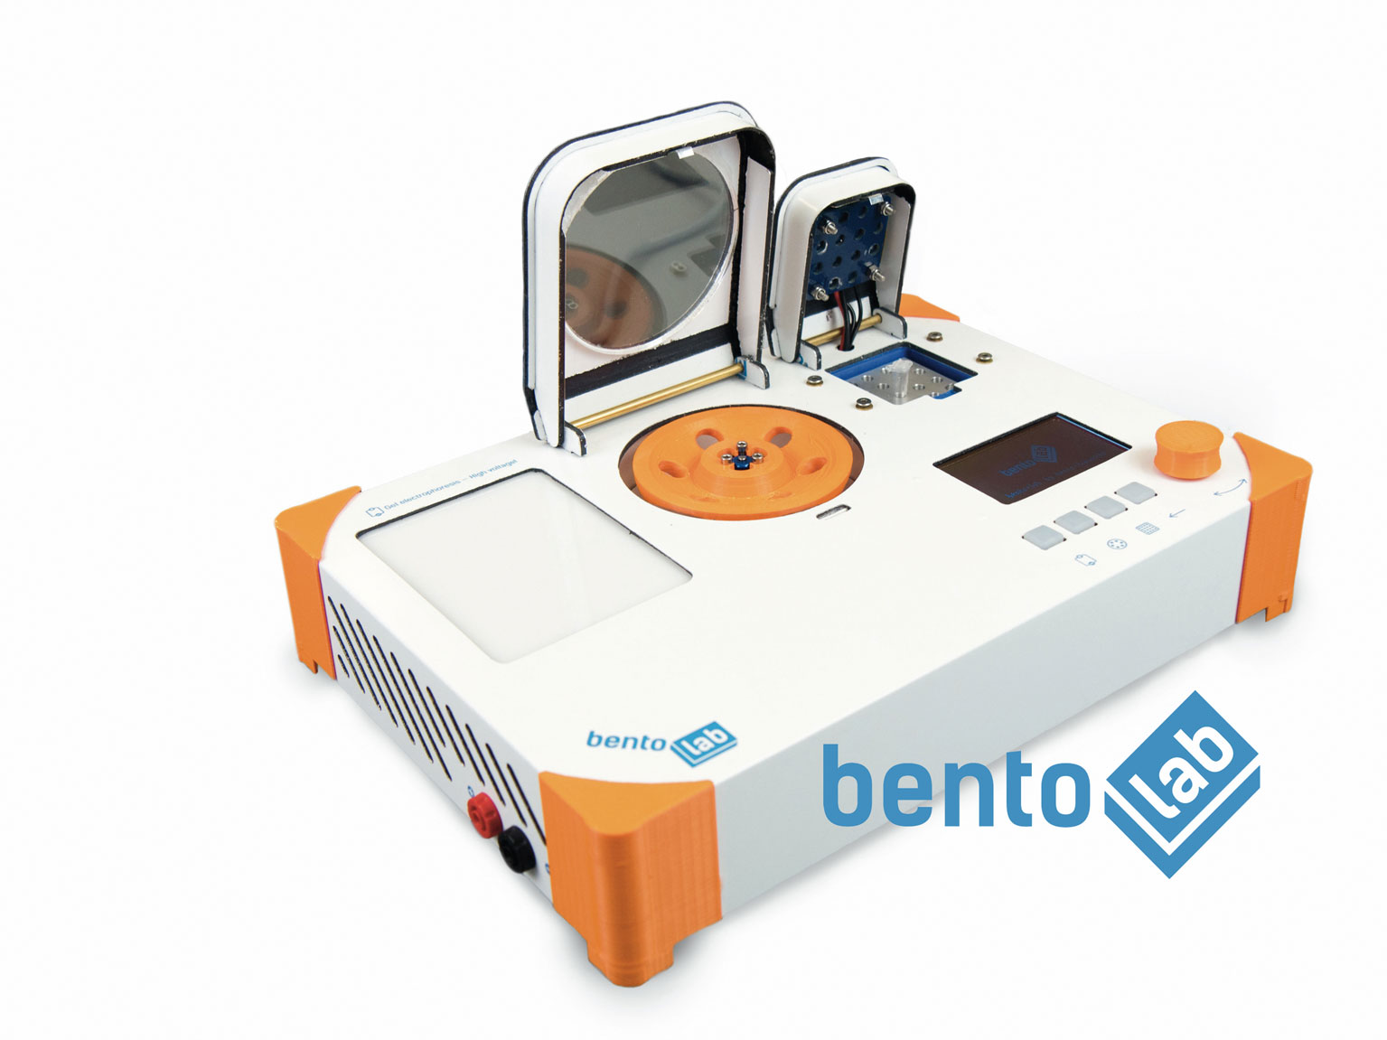
Workflow
Oxford Nanopore MinION

Slide 12
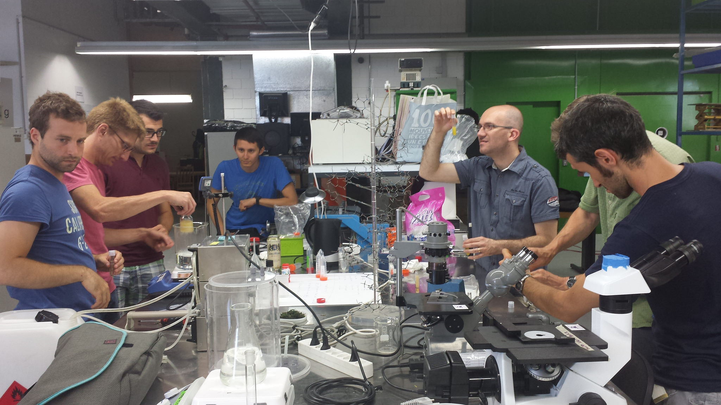
Beer DNA extraction workshops

Slide 13
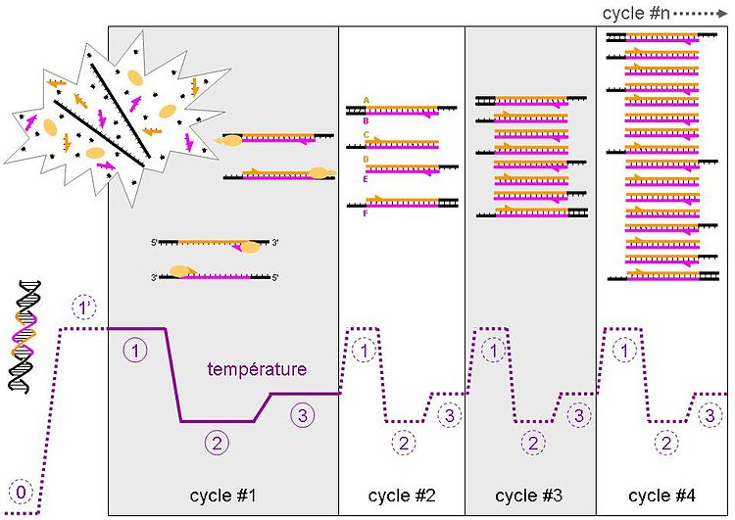
Polymerase chain reaction (PCR)
Amplification of Internal transcribed spacer (ITS) sequences and library prep.

Slide 14
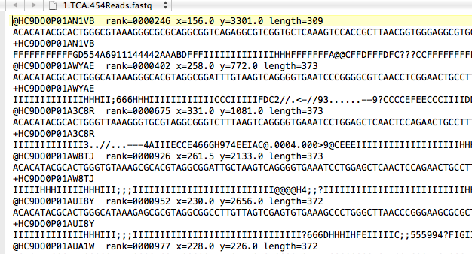
Sequencer output

Slide 15
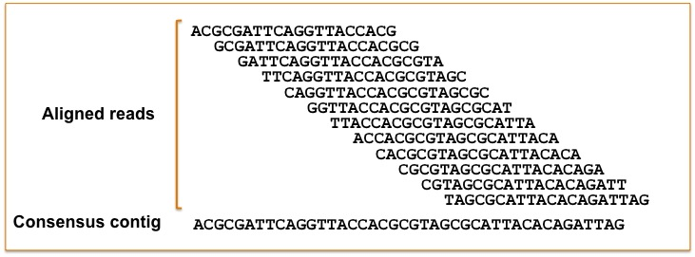
Short reads alignment
Reference sequence
Data base of ITS sequences

Slide 16

Results
ITS amplicon of 39 beer DNA produced
SRA database in the bio project PRJNA388541
All methods, quality control, processed tables, metadata and code are accessible in the following git repository: https://github.com/beerdecoded/Beer_ITS_analysis

Slide 17
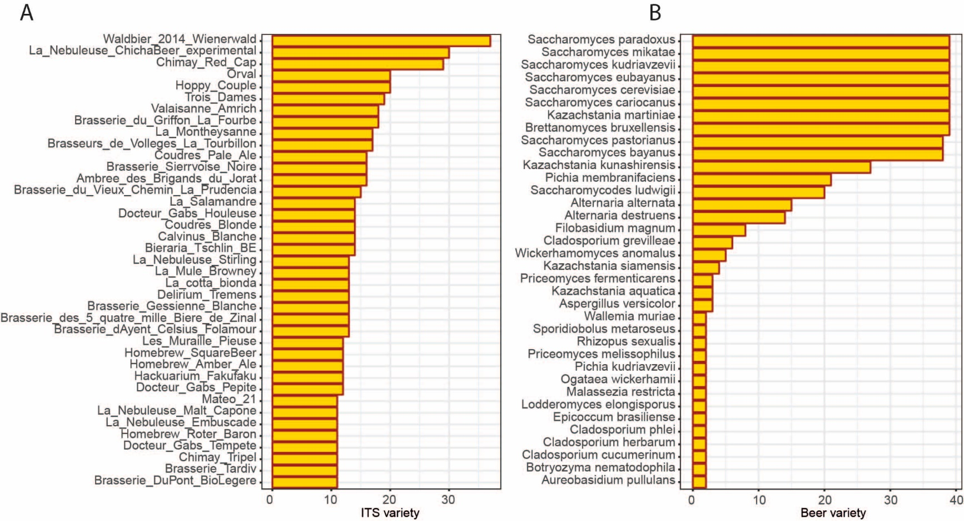


Results

Slide 18
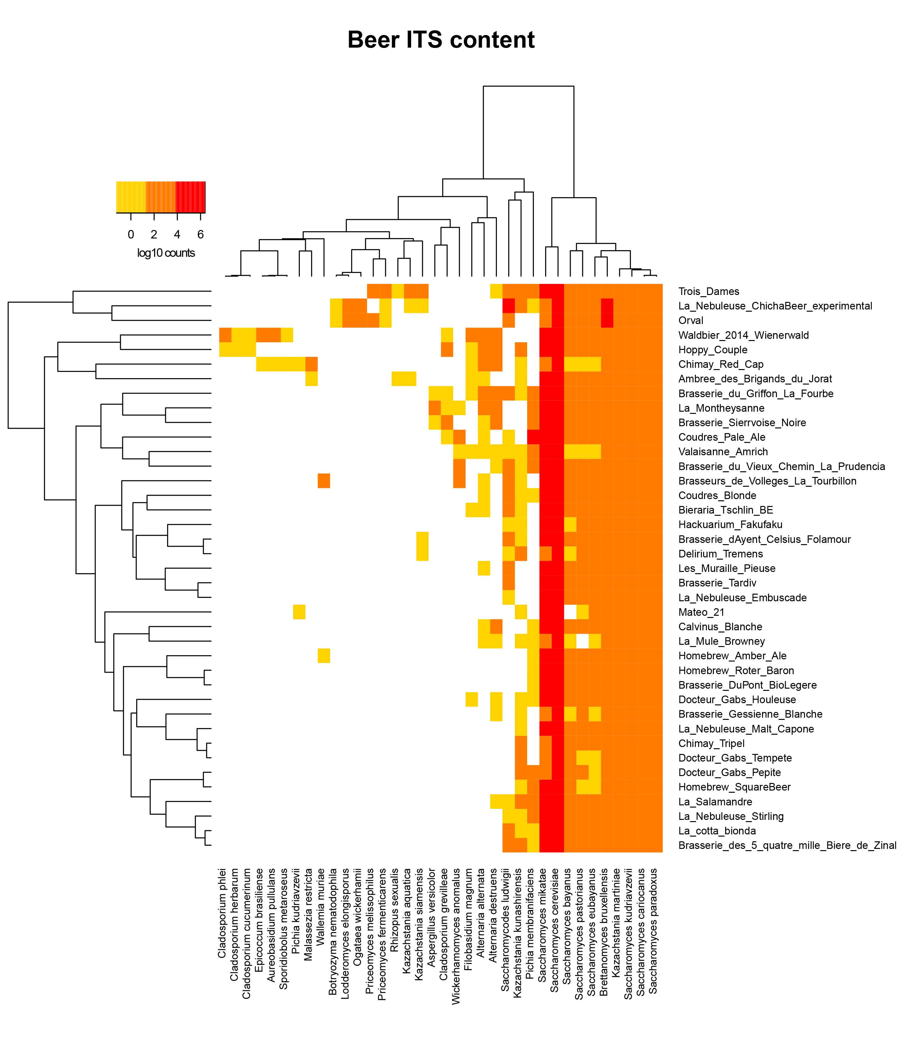


Results

Slide 19




Manuscript preparation process
Google docs
Authorea
Overleaf
F1000
Sobel J, Henry L, Rotman N and Rando G. BeerDeCoded: the open beer metagenome project [version 1; referees: 3 approved with reservations]. F1000Research 2017, 6:1676

Slide 20
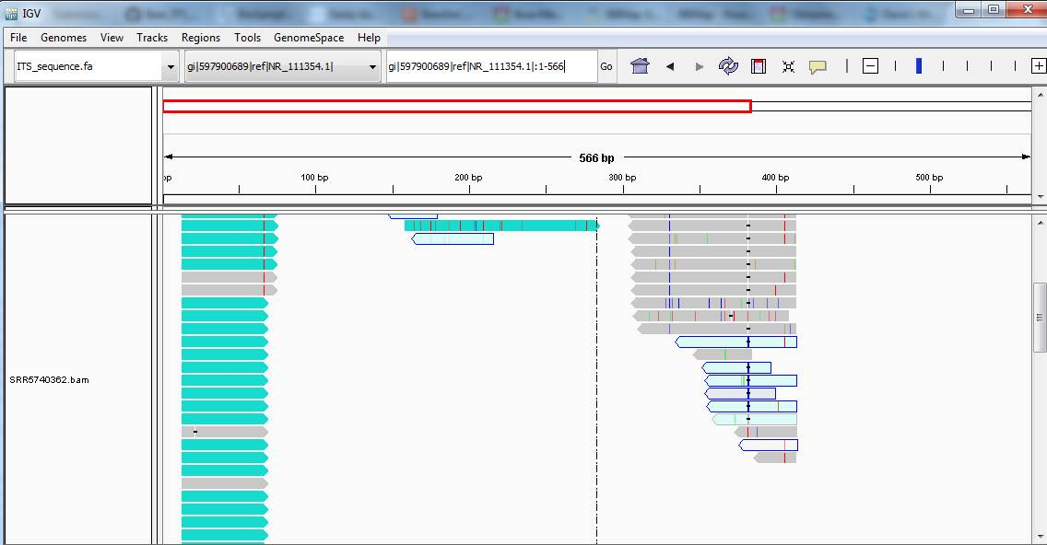

Results review
Kristoffer Krogerus

Slide 21

Outcome of the project
39 beer investigated (currently)
Knowledge of Beer DNA content
Popularization of molecular biology techniques
Ethical Issues regarding DNA related data

Slide 22

Perspectives
Involvement of other citizen science lab
Investigation of 16S sequences
Investigation of whole metagenome sequencing
Development of the protocol for the MinION sequencer
Development of a beer knowledge data base
Beer Quality Controls
Relationship between taste and DNA content

Slide 23

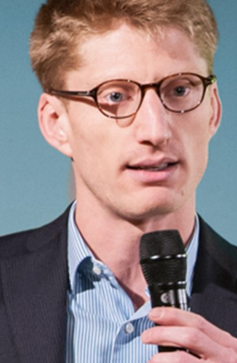
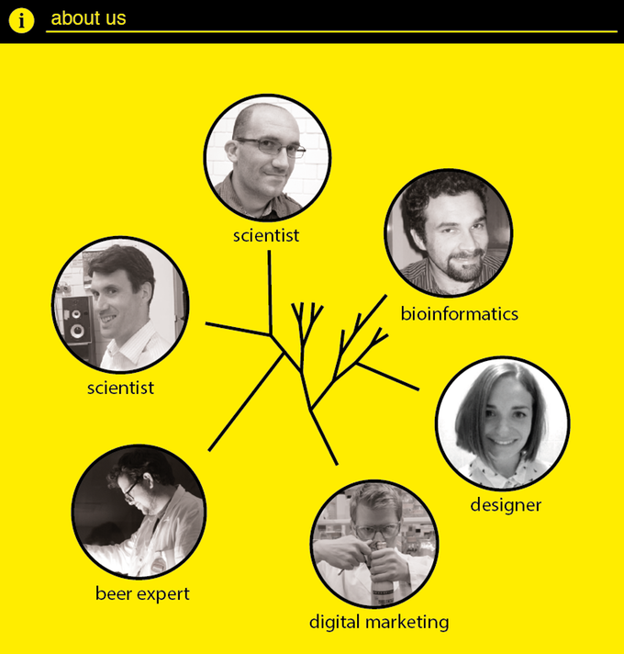


Acknowledgments
BeerDecoded Team
Hackuarium
UniverCité
Kickstarter (Backer)
Vital-it
OBF Travel Grant

